Slide 1












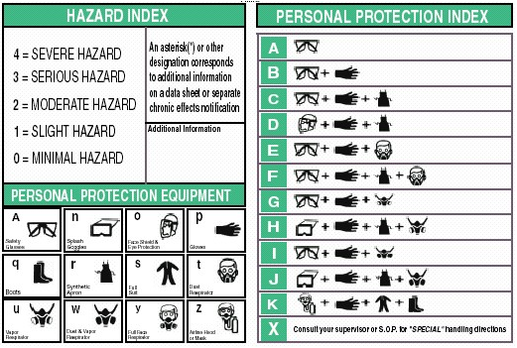
GHS Label detailed instructions
Global GHS Label danger icon for the background: white Symbol: Black Border: Red
Causticity Causes severe skin burns and eye burns May be corrosive to metals
Pressurized gas Contains gas under pressure; may explode if heated Contains refrigerated gas; may cryogenic burns
Explosive Fire, blast or projection hazard May mass explode in fire Unstable explosives May explode if heated
Environmental pollution
Fatal in contact with skin Toxic in contact with skin Fatal if swallowed. Inhalation Fatal Toxic if swallowed. Inhalation of toxic
May cause fire or explosion; strong oxidants May intensify fire or explosion; strong oxidants
Toxic in contact with skin Ingestion, inhalation, skin contact with harmful May cause skin and eye irritation or allergy May cause respiratory irritation or may cause drowsiness or dizziness
May cause cancer, may cause genetic defects Long-term or repeated exposure may cause damage to organs May damage fertility or the unborn child Inhalation or ingestion may cause allergy or asthma symptoms or breathing difficulties, severe fatal
Overheating may cause a fire Or extremely flammable gases Flammable plastic, flammable solids Flammable liquid and vapor Fire spontaneously if exposed to air Water, emit flammable gases may spontaneous combustion or a Volume may be self-heating or spontaneous combustion when possible
No data impact Harmless
At present we lack information GHS Label radiation may increase in the future
0,1,2,3,4 five levels affect the health of 0 is no effect, 4 are seriously affected
Ignition points 0,1,2,3,4 five levels 0 is no effect, four are seriously affected
The reaction of 0,1,2,3,4 five levels 0 is no effect 4 is severely affected
HEALTH | 1
FLAMMABILITY | 1
REACTIVITY | 0
PERSONAL PROTECTION | C
Tristar Aero Technology, Inc. www.ghstag.com

